Slide 1
Educology for Systemic Change
Theodore Frick
Professor Emeritus, Department of Instructional Systems Technology
Indiana University Bloomington
Kenneth Thompson
Independent Researcher, Systems Predictive Technologies, Columbus, OH

Slide 2
The Problem: No Adequate Theory
K-12 schools under increasing pressure with NCLB (No Child Left Behind)
Failing schools have real incentive to change
Question is: Change what?
Attempts to change will be trial and error if no valid theory
What we need is good theory
For good theory, we need educology!

Slide 3
Bridge Analogy
Consider an old bridge that is failing
  Structurally weak
  Too few lanes for traffic
  Traffic increasing
If not fixed, will collapse: vehicles plunge into river
Would we build a new bridge by trial and error?
Would we let politicians do it?

Slide 4
Bridge Analogy Cont’d
No, we would not build a bridge by trial and error!
Politicians have already implemented laws/policies that are harming students and their teachers. E.g., by:
  Creating teacher shortages and decreased enrollments in teacher education programs across the U.S.
  Mandating too many very expensive unnecessary standardized tests.
  Driving students away from public schools into private schools.
  Creating unfair and unjust teacher evaluation requirements.
  Failing to show any significant improvements in student learning as measured by standardized tests.
  Driving good teachers away from public schools due to teacher-bashing in the media.

Slide 5
Bridge Analogy Cont’d
Modern engineers use proven scientific theories: Newtonian physics, classical mechanics, statics, structural engineering
But in education, we are attempting to change systems largely by trial and error, i.e., trying solutions not based on educology.

Slide 6
We Need Educational Systems Theory
Lewin: “There is nothing so practical as good theory.”
We have theories of:
  Instruction
  Learning
  Pedagogy, e.g., Montessori method
We have no educational systems theory

Slide 7
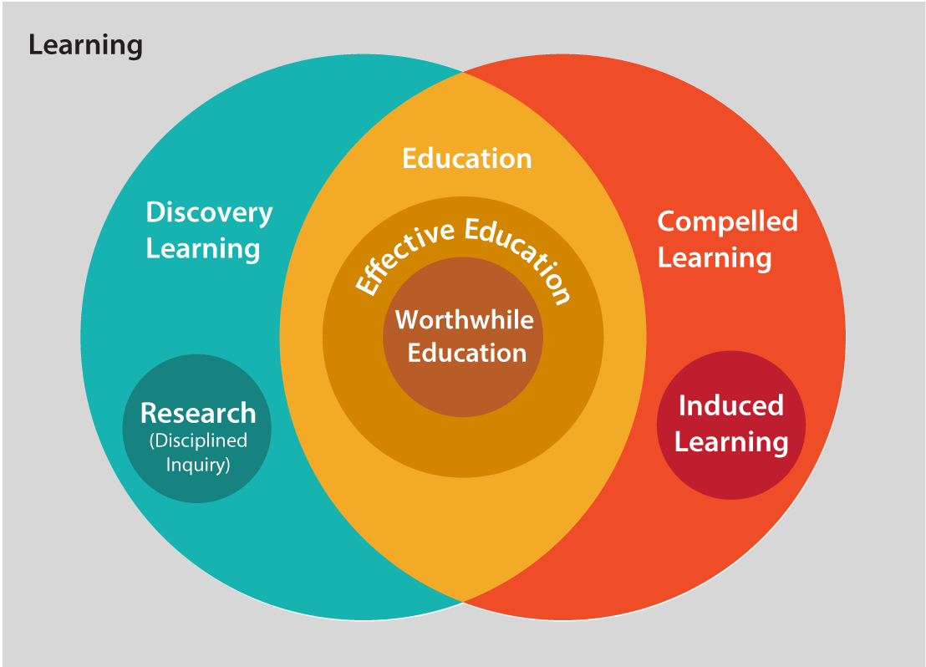
We need educology to create new theory
What is educology? Knowledge of education. See educology website.
Currently ranked 2nd in the world in Google search for ‘educology’ (after Wikipedia entry)
View website and illustrate definitions of terms necessary for educational systems theory development

Slide 8
Educational Systems Theory: EST
EST developed thus far:
  Builds on work of Maccia & Maccia (1966)
  Builds on work of Frick, et al. (1994) on basic, dynamic, and structural properties of systems (Simulosophy – at Asilomar Conference.)
  Axiomatic Theories of Intentional Systems now serves as foundation (Thompson, 2005)
  Educology provides well-defined terms required for theory development – so we are clear about what we are talking about!

Slide 9
EST in Action
To make this more concrete, consider the following scenario:
Smithtown School #9 failed to achieve state standards for NCLB

Slide 10
EST in Action - Scenario
SMITHTOWN SCHOOL #9
Parents start transferring
children to other schools

Slide 11
EST Predictions – Axiom 13
If input decreases
Then filtration increases
SMITHTOWN SCHOOL #9
This is a FAILING
school. Tommy
shouldn’t enroll here!
Enrollment falls
NCLB rating deters enrollment

Slide 12
EST Predictions – Axiom 11
If input decreases
Then storeput decreases
Fewer students attending
classes
Enrollment falls

Slide 13
EST Predictions – Axiom 10
If input decreases
Then fromput decreases
Hmm…there aren’t as many
diplomas to print this year!
ADMINISTRATION
OFFICE
Enrollment falls
Fewer students to graduate

Slide 14
EST Predictions – Axiom 16
If input decreases
Then feedout decreases
Enrollment falls
Fewer graduates

Slide 15
EST Predictions – Axiom 28
If filtration increases
Then adaptability increases
SMITHTOWN SCHOOL #9 BOARD MEETING AGENDA:
How to improve
achievement scores?
SMITHTOWN SCHOOL #9
This is a FAILING
school. Tommy
shouldn’t enroll here!
NCLB rating deters enrollment
Smithtown adapts to
maintain system stability

Slide 16
Using EST with Smithtown’s adaptation strategies
How can Smithtown adapt? Change the structure – i.e., the affect relations.
What if Smithtown increases STRONGNESS of affect relations that are of
type: guidance of learning?

Slide 17
Smithtown’s proposed strategy
Increase avenues of instruction through:
  Teaching aides
  Peer tutoring
  Instructional technology e.g. using e-Learning software
Increase strongness

Slide 18
EST Predictions – Axiom 56
If strongness increases
Then hierarchical order decreases
GUIDE
Teaching
aides
Teachers
GUIDE
GUIDE
GUIDE
GUIDE
E-learning
software
Peer
tutoring
GUIDE
More ‘guidance of learning’ connections for students
After: Less concentration on
teacher as guide of learning
Before: Teacher is main guide
of learning

Slide 19
EST Predictions – Axiom 55
If strongness increases
Then flexibility increases
Teaching
aides
Teachers
Teaching
aides
Teachers
E-learning
software
Peer
tutoring
E-learning
software
Peer
tutoring
More ‘guidance of learning’ connections for students
More different ways for guiding learning of students

Slide 20
EST Predictions – Axiom 108
If strongness increases
Then filtration decreases
Teaching
aides
Teachers
SMITHTOWN SCHOOL #9
SUCCESS
FAILURE
They’ve made AYP. Tommy can enroll here!
E-learning
software
Peer
tutoring
More ‘guidance of learning’ connections for students
Smithtown #9 makes NCLB
rating. This encourages enrollment.
AYP = Annual Yearly Progress (part of NCLB law)

Slide 21
EST Predictions – Axiom 144
If strongness increases
Then isomorphism increases
Increase
strongness
Increase
strongness
SMITHTOWN SCHOOL #9
SMITHTOWN SCHOOL #5
SMITHTOWN SCHOOL #1
They’ve improved
achievement scores and
made AYP. Tommy can
enroll here!
SUCCESS
SMITHTOWN SCHOOL #9
Increase
strongness
Increase
strongness
SMITHTOWN SCHOOL #12
SMITHTOWN SCHOOL #25
Smithtown #9 makes NCLB
rating.This raises enrollment.
Smithtown replicates success
strategy for more schools
AYP = Annual Yearly Progress (part of NCLB law)

Slide 22
EST Predictions – Axiom 106
If strongness increases
Then toput increases
SMITHTOWN SCHOOLS
Teaching
aides
Teachers
E-learning
software
Peer
tutoring
More students seek enrollment
at Smithtown as student achievement improves
More ‘guidance of learning’ connections for students

Slide 23
What effects are predicted by EST when number of applicants to Smithtown increases?
In other words, what if TOPUT increases?

Slide 24
EST Predictions – Axiom 8
If toput increases
Then filtration decreases to some value
and then increases
SMITHTOWN SCHOOLS
WE’RE FULL!
WE’RE FULL!
SUCCESS
SUCCESS
FAILED
FAILED
SMITHTOWN SCHOOL #5
WE’RE FULL!
SMITHTOWN SCHOOL #1
SUCCESS
WE’RE FULL!
FAILED
SUCCESS
SMITHTOWN SCHOOL #9
FAILED
SMITHTOWN SCHOOL #25
SMITHTOWN SCHOOL #12
More students seek enrollment
at Smithtown as student
achievement improves
Enrollment becomes harder when
Smithtown’s quota is reached. More
Smithtown schools make AYP.

Slide 25
EST Predictions – Axiom 5
If toput increases
Then input increases to some value and then decreases
There are too many
students! I cannot cope!
SMITHTOWN SCHOOLS
More students seek enrollment
at Smithtown as student
achievement improves.
Enrollment increases and there is over-crowding in classrooms. Students start to leave Smithtown schools as teaching quality falls.

Slide 26
EST Predictions – Axiom 90
If toput increases
Then centrality decreases
SMITHTOWN SCHOOLS
SMITHTOWN SCHOOL SYSTEM
NEIGHBORING SCHOOL SYSTEM
More students seek enrollment
at Smithtown as student
achievement improves.
Some students leave Smithtown
for a neighboring school system.

Slide 27
EST Predictions – Axiom 9
If toput increases
Then regulation less than some value increases
SMITHTOWN SCHOOL CORPORATION MEETING
Raising graduation standards in schools
SMITHTOWN SCHOOLS
More students seek enrollment
at Smithtown as student
achievement improves.
Smithtown School Corporation
changes policies to raise graduation
standards in schools.

Slide 28
Conclusion
Lewin: “There is nothing so practical as good theory
Do we want to design new educational systems or change current systems by trial and error?

Slide 29
Conclusion
We believe that a scientifically valid educational systems theory will help us make intelligent changes.
Educology is knowledge of education.
Scientific knowledge of education requires educational systems theory that has been empirically verified.
Good theory requires well-defined terms. See the new educology website (online since Feb., 2015).

Slide 30
Thank you. Questions?
URLs for further info:
Educology:
http://educology.indiana.edu/index.html
SimEd Technologies:https://www.indiana.edu/~simed/overview/
ATIS: Axiomatic Theories of Intentional Systems:
http://www.indiana.edu/~aptac/glossary/atisTheory.html

